Slide 1
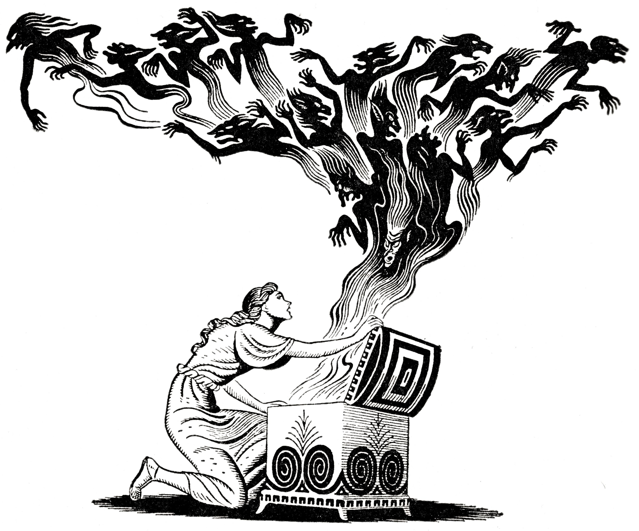
Gifted
The neglected segment
By
Kostas Bonikos
www.linkedin.com/in/kostas-bonikos

Slide 2
Disclaimer
Please note that I am not a specialist in any of the areas where opinion is offered
Everything in the following presentation is entirely my opinion and does not reflect the policies or opinions of any current or former employers of mine
These opinions reflect my personal experience of the subject and of life and are bound to be biased. Please do your own checking
If terminology has been used that you find insensitive, I assure you that is has been used without any intent to cause anyone to suffer and it only reflects my limited vocabulary. Please accept my unreserved apologies
If anything here offends you in principle, such as politically or religiously, I am afraid that is tough. See it as a good opportunity to grow tolerance
If you would like any further information, links, anecdotes or completely partial and biased advice, feel free to contact me and I will happily rant further

Slide 3
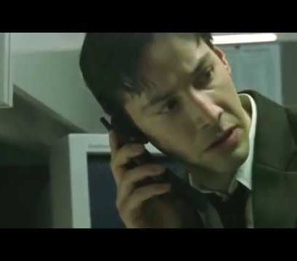
1. Have you been out of sync? Or know someone who is? Have you experienced the terror of realising you are smarter than your doctor?
People are different, not the same, not equal in all domains
We welcome and encourage diversity
Unless the people in question are better at something than us
Do you suspect there is something wrong with how you fit in?
Someone said that lowly people discuss people, ordinary events and great people discuss ideas
So, how is your social life?

Slide 4
2. A note on mental differences (low IQ, disturbed, high IQ, autism, other)
What is the opposite word of disability?
Some people have low IQ, we accept and accommodate their needs
Some people are mentally ill, we may all go through this; have you noticed how differently they are treated to those with low IQ?
Some people are on the Autistic spectrum. Cyber firms love them. We are all on that spectrum somewhere, it’s ok.
There are other mental differences that cause take away from average abilities. They are all respected and should be.

Slide 5
3. Why Gifted? Because just ‘IQ’ or ‘intelligence’ won’t cut it. The Intelligence “Tree”
What about those who are different because they can do some things better?
The Intelligence Tree:
IQ was devised to assess mental disability
Its area of applicability stops after slightly above normal
After someone is ‘very smart’ their type of intelligence may branch off to specific gifts like mathematics, painting, dance, or emotional intelligence.
There are few Da Vinci people
So, your IQ may not be at 150 but your equivalent abilities may be well above that.

Slide 6
4. Who could be Gifted? Symptoms
They often discuss ideas
They seem to care in a non-self-promoting way
They are passionate about something they enjoy
They make others feel more intelligent (they can explain things)
They are about as odd as the learning disabled
They often have unusual life paths, some even go into crime
More often than not, they do not enjoy happy lives

Slide 7
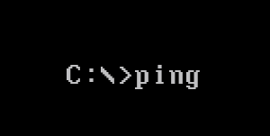
5. What this talk is about, Stimulus not results
This subject cannot be thoroughly covered in an hour
It touches many aspect of the human experience
The purpose of this talk is to provide a stimulus for research and self-enquiry
Some basic and broad directions will be given to enable you to be aware of the subject and know where to start
And how to look ;-)

Slide 8
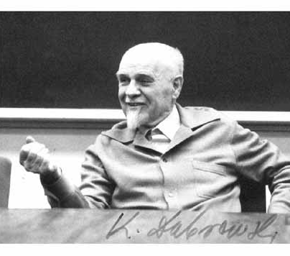
6. Yes, you are crazy, dégénéré supérieur?
The term was coined by Kazimierz Dabrowski
Other crazy people:
Jack Parsons
Nikola Tesla
Jerome Lettvin
Ilya Ivanov
Arthur C. Clarke
James Lovelock
…and many more.

Slide 9
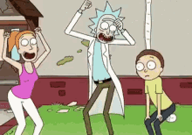
7. Over-excitability! I cannot believe what I am seeing!
My theory is that surrealism was born out of a need to express in art the apparent irrationality of the world
There is something you may have to deal with and learn to control and channel.
Detail stands out
Things may be obvious to you but not others
Important things, urgent things
Amazing new knowledge
Principles!
It is all about the inherent motivation that makes someone gifted

Slide 10
8. The Unbalanced Mind; Neurosis or Progress? - unstable (aero) dynamics
Perfectly balanced people are indifferent
Sometimes a healthy dose of neurosis is essential for excellence
Awareness is the key to maintaining mental health
Nobody has prepared you for this, you have to do it yourself
A gifted mind is unbalanced and controlled
Fighter jets are aerodynamically unbalanced and fly by constant computer control – this gives them the requisite agility
Control requires discipline and actual advanced abilities and skills which have to be inherited and learned respectively
This is not a necessity for most ‘normal’ people
There is a fine line between genius and madness and the relationship is one-way unfortunately

Slide 11
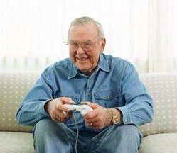
9. Asynchronous emotional development
Gifted people are often just big kids
Or small adults and then big kids
Or something else
They do not pack the same gear, they do not grow at the same rate. They need special care growing up
Reality does not solidify as early or completely as normal
With discipline, this is a good thing as one needs a child's mind to be creative
If they were not childish they would not watch and write sci-fi and they would not invent anything
Beware of this, it cuts both ways

Slide 12
10. Coexisting problems: ADD/ADHD, autism, mood disorders. Finding a good specialist
I have what used to be a severe learning difficulty 500 years ago – astigmatism
Just because someone is smart, it does not mean they are perfect. As people, they may have other difficulties, being smart does not mean they are automatically overcome
Overexcitability can border on ADD or ADHD
Not all autistics are savants but many savants are on the spectrum. This is not a disability any more but some people still make fun of others with glasses
If you are gifted and haven’t experienced some form of mood disorder, please come and see me, I want to know how you did it
Find a good specialist who understands giftedness – most “doctors” have a laminated card with what to prescribe
Thankfully, medical school is difficult so there’s lots of gifted doctors, find the ones who care

Slide 13
11. Isolation - guess which group is over-represented in prisons, the “loser” genius
Clearly, there are no support networks for gifted people
Except MENSA and some others but let’s not get into that
Isolation is a real problem, if you have a diagnosed disability, it is fine to seek support groups but if you are gifted, how do you go about seeking contacts without it going horribly wrong?
My lesson is that there is no stereotype genius, look for it everywhere, develop a gifted-dar but be aware that gifted people live vastly diverse, weird and wonderful lives and may not have time for you
You can also hang out with dead people by reading symbols that cause you to commune with them and hallucinate wildly (books)
Also, any society of people who pursue difficult things for fun should contain some gifted ones

Slide 14
11. You have to be on the lookout for them

Slide 15
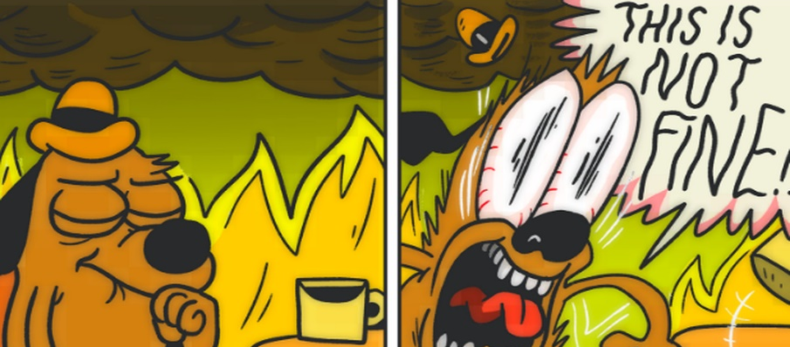
12. School - boring, boring, boring, the floor is on fire (I have no study skills) - the tragedy of the glimpse of genius with lack of discipline
Tall people are terrible at basketball by default
People who play basketball get good at it
This is especially important if you have children
If their learning environment is not challenging, they will not develop the necessary study skills and many other skills
School is for skills not knowledge. You can learn a high school curriculum in a week but you cannot learn to manage learning and the world overnight
Or learn about time management and hard work
The No.1 cause of losers is lack of discipline
The Dunning-Kruger effect is a blessing for most but having access to your inner genius and watching it go to waste while others, more disciplined are surpassing you is a frequent and avoidable tragedy

Slide 16
13. Work - it is not funny if the joke is on you
The good news is you can change jobs and interviews work both ways
Learn to recognise narcissists and psychopaths, treat the rest kindly

Slide 17
13. Work - it is not funny if the joke is on you
Be aware of the Dreyfus model of skill acquisition. It will help you fill the gaps
Manage your own career
Seek emotional intelligence skills and practice them
If you haven’t walked out yet, you probably know that being gifted is just a tool, the work does not do itself
Learn patience and mindfulness. They are both skills that you have to keep practicing to maintain, not like riding a bike

Slide 18
14. Dating: when love dolls look like a viable option
My prediction is that when they are perfected people will use them to do the housework more than anything else (like real husbands)
Finding the right person for you is going to be hard. Do not settle!
If they watch trash TV and read tabloids they will only do for a while do not lead people on, this is a time-bound game
Most importantly, take the time to gain skills in dating. People who spent less time in the library are ahead of you
Just being smart is like just being handsome / pretty – character is the most important thing to look for – but sort of equal intellect too
This is going to come in handy when you have to talk to them or when you decide to pursue another PhD when you are 65

Slide 19
15. Gifted children - heredity, bot-teachers, bullying, stimulation resources
Children of the gifted are often gifted, it is hereditary
Gifted children achieve almost everything effortlessly, as a result, other children lose motivation, teachers get offended or jealous
It is very hard dealing with people smarter than you, especially at your subject
Gifted children are in grave danger of becoming arrogant
They present prime targets for bullies
There are special resources to help guide their development
Like with anything else, don’t take anything for granted, there are resources if you look for them and you need discipline to use them and gain skills

Slide 20
16. What now: Tune in, drop out, find the others - the problem is defined - responsibility
The ball is in your court now. You have been alerted to the existence of gifted people. It is your responsibility to make a plan of action and carry it through
You cannot expect some organization to hold your hand
Accept your differences, the lost time, the missed opportunities and the bad habits and move on
You do not have to fit in. The wider society is beginning to see this as unnecessary, other times and places would not be so forgiving
Find other people like you. You may see them once or every week, most of them will not become your friends if you are an adult, it’s ok, just spotting them and knowing they exist is enough
Make sure your family understand you or that you know their limits

Slide 21
17. Tune in: Books, online resources, remarkable historical figures
You will find links at the end of this presentation
There are books out there that deal with the subject, you do not need to read all of them
Even better, there are books written by gifted people; you will find those more comforting. Beware of the ghost-written entertainment “smart” books. Typically, reading the back cover is enough
Learn about historical personalities that were weird and gifted and you will feel less isolated and crazy (they have the same crazy ideas)

Slide 22
18. Drop out: You are not part of this reality, learn to cope, don’t try to fit in too much
I have mentioned this before but it is important that I repeat myself for emphasis
Nobody likes a nobody
People can tell you are different but they will not tolerate you if you are not genuine and kind
You cannot be genuine unless you find yourself. Travel! (outside of your own head)
Actively learn about people and the world and then experience it first-hand. Have stories for your grandchildren
When you test something, you give it a stimulus and read the response. Travel will give you inputs for :
Unit Testing – bits of yourself (beliefs, opinions), did you chose those?
Integration Testing – your personality – did you configure this? Or, was it formed by reactions?
System Testing – your body, mind, family and friends – are you coherent?
Acceptance Testing – Are the users going to be happy? Can you function in society for the results you want?

Slide 23
19. Find the others: friends, love, my first flash-mob
My first flash-mob, possibly the first one in Greece
You always used to find like-minded but diverse people on a BBS – what is your BBS now without the posers?
By all means love. Spouses, children, friends, pets, books etc. There’s hundreds of books on motivation but it is simpler than that.
Be aware that not everyone has the same depth of experience. Some see the moon, some just the finger that points to it.
In both cases, there is no need to explain.
Do not wish for a world that everyone is like you, there you would be normal and some others would again be gifted.
Avoid must-turbation. Just because you know better…

Slide 24
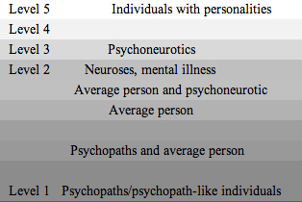
20. Positive disintegration and Dabrowski’s levels of personality (image stolen from the internet)

Slide 25
20. Positive disintegration and Dabrowski’s levels of personality
The inevitable breakdown is necessary in order to reconstitute yourself in accordance to your will
This is because you get the same data as everyone else but more meaning
My only warning is: be humble and cautious designing the new self because your current self isn’t as wise as the future one
Allow for more iterations, it doesn’t stop, you just get good at it

Slide 26
21. Too late? - remember 10 years ago when you thought it was too late? Time travel
There is a paradox in our thinking, that it is too late
For some things, it is. But for more than we think, it is not
In order to survive you need to keep learning more than normal life demands and it is never too late for that
Everyone wishes they could travel back in time and change that little thing and things now would be so great
The fact is, you are not much smarter now than you were then and you could most likely simulate what the best advice would have been. You just chose not to go that way

Slide 27
21. Too late? - remember 10 years ago when you thought it was too late? Time travel
Bear in mind that now is 10, 20 or 50 years in the past from a future point of view
What could you do now that your future self would thank you for
Remember, they will be too old to do what you can do now
Set them up for health, happiness and success
Try simulating your future self and write a letter to your current one, what would they write to you? Do this in small paragraphs first thing in the morning for a month

Slide 28
22. How to survive: humility, mindfulness, kindness
These are not touchy-feely points
Humility will get you out of more trouble than you can imagine
The greatest obstacle to any success is success
Learn and practice mindfulness, don’t be a spectator
Kindness makes friends and is good for your health. So when you feel most unkind, that’s when you need it most, do something kind and break the cycle
What does the above have to do with being gifted? If has to do with being challenged

Slide 29
23. What if you are not gifted? What I learned from autism and learning disabled people
This advice applies to all, if you are not smarter than the average person, you are still a lot smarter than a lot of people and your life is not that different in the basics
And if you are a certified genius, there are still people to whom you are an amoeba
I learned that IQ has nothing to do with moral character
I have been humbled by the tenacity of some learning disabled people and appalled by the sloth and arrogance of “misunderstood” geniuses
Autism taught me that you can repurpose your resources to overcome your shortcomings and find purpose for your “shortcomings” that makes them talents

Slide 30
In Conclusion
I hope to have succeeded in making you aware of the existence of gifted people
Of their need for tailored education and career management
That they can’t figure it out themselves since they are so smart
That a deviation from the norm causes difficulties
That it is not ok to envy them, or taller, or stronger, or prettier people. Imagine being them in this world
That if you are or know one, there is help, it’s just not on the curriculum

Slide 31
References and Links
http://www.positivedisintegration.com/
https://www.technologyreview.com/s/508376/in-a-frogs-eye/
https://web.northeastern.edu/slavovlab/blog/2014/08/15/papers-that-triumphed-over-their-rejections/
https://www.bestcollegereviews.org/10-incredible-real-life-mad-scientists/
https://www.wired.com/2011/05/0525arthur-c-clarke-proposes-geostationary-satellites/
https://en.wikipedia.org/wiki/Dreyfus_model_of_skill_acquisition
https://en.wikipedia.org/wiki/Erik_von_Markovik
http://www.gifteddevelopment.com/
https://davincilearning.wordpress.com/2010/08/20/clues-on-finding-a-therapist-for-a-gifted-client/
http://www.hoagiesgifted.org/
http://sengifted.org/ http://www.davincilearning.org/resources.html
https://www.youtube.com/watch?v=O-I03ZmhovQ
https://www.youtube.com/watch?v=Xfev7C6Ca4o

Slide 32
References and Links
https://www.e-reading.club/bookreader.php/137202/Hunt_-_Pragmatic_Thinking_and_Learning_-_Refactor_Your_Wetware.pdf
http://pespmc1.vub.ac.be/Papers/GiftedProblems.pdf
http://www.davidsongifted.org/Search-Database/entry/A10495
https://www.amazon.co.uk/Gifted-Grownups-Blessings-Extraordinary-Potentials/dp/0471295809/ref=sr_1_5?keywords=gifted+grownups&qid=1569487029&s=books&sr=1-5
https://medium.com/@ElfMachine/what-are-the-signs-of-a-highly-gifted-adults-and-children-7942e2105879
Some Links that have been shared with me since the talk:
https://www.gov.uk/access-to-work
https://www.amazon.co.uk/Succeed-Employment-Specific-Learning-Difficulties/dp/0285642464
https://www.amazon.co.uk/Employers-Managing-Professionals-Autism-Spectrum-ebook/dp/B0746TDCFB
https://www.amazon.co.uk/Asperger-Syndrome-Employment-People-Really/dp/1843106779/
https://www.geniuswithin.co.uk/blog/access-to-work-how-does-that-work/

